Slide 1
Yotuh Energy
Telematics EVT2

Slide 2
Requirements:
We need to monitor various performance parameters of our products.
Collect data from IOT Hardware
Store/Process this on back end cloud
Front end - web/app development
IOT Hardware is TFT100.

Slide 3
Data Collection;
CAN Data sent from Yotuh ECU
Data collected from IOT Hardware

Slide 4
CAN Data sent from Yotuh ECU
Temperature Sensor 1
Temperature Sensor 2
Temperature Sensor 3
Temperature Sensor 4
Temperature Sensor 5
Temperature sensor 6
Temperature sensor 7
Temperature Sensor 8
Box Temperature
Discharge Pressure
Suction Pressure
Compressor Current
Compressor RPM
14. Set Point
15. TTD/TTD
16. Hysteresis
17. Driver Switch
18. Cooling State
19. Defrost State
20. Door State
21. Standby Switch
22. Charging Status
23. Charging Interlock
24. Error State
25. Warning State
26. SOC
27. Voltage
28. Current
29. SOH
30. Max Cell Voltage
31. Min Cell Voltage
32. Max Cell Temperature
33. Min Cell Temperature
34. Charge/Discharge Cycles
35. CAN Frame 8
All these will be useful in front end

Slide 5
Data Collected from IOT Hardware
Total Odometer
Axis X
Axis Y
Axis Z
GSM signal
Vehicle Speed
External Voltage
Battery Voltage
Battery Current
GNSS Status
Dallas Temp 1
Dallas Temp 1 ID
Dallas Temp 2 ID
Battery Level
15. GNSS PDOP
16. GNSS HDOP
17. Trip Odometer
18. Sleep Mode
19. Ignition
20. Movement
21. Active GSM Operator
22. Timestamp
23. Record Priority
24. Latitude and Longitude
25. Altitude
26. Angle
27. Number of Satellites Visible
28. sp , Speed
Only Bold Parameters are useful in front end.

Slide 6
Home Login Page
We will manually give each one of them a
Customer ID and PWD.
Say,
Yotuhepl - 5 vehicles
track@01
sragro - 3 vehicles
123pwd
Nrcpvtltd - 2 vehicles
coldtrack
And depending upon which customer is logging in, we will have their specific vehicle assigned to them.

Slide 7
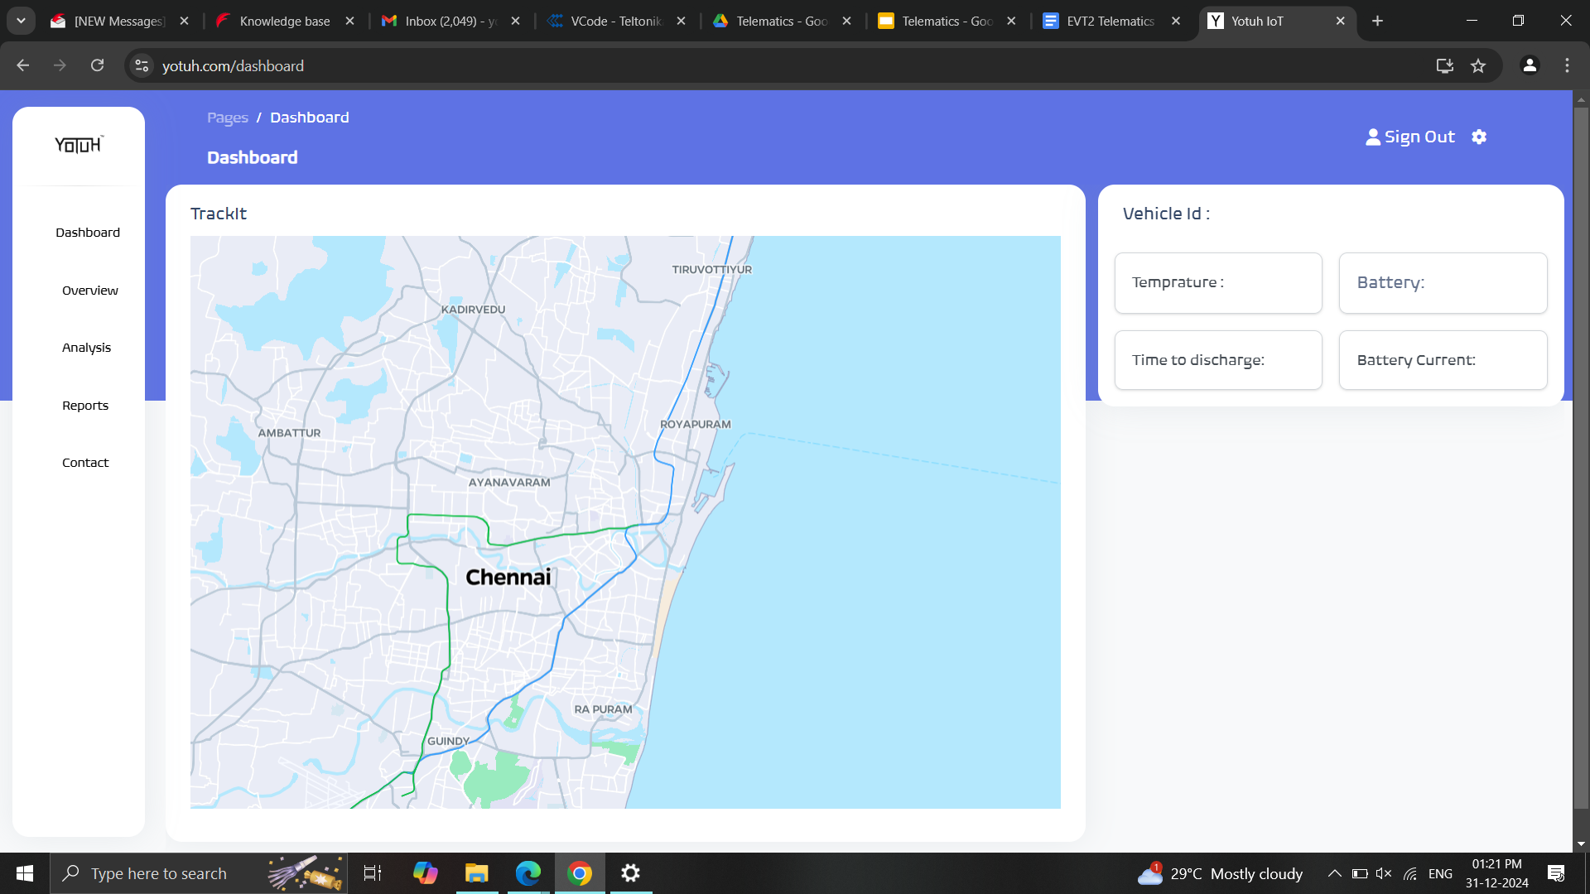
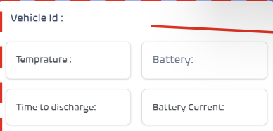
Home Page after Log in
Menus
1. Dashboard
2. Overview
3. Analysis
4. Reports
5. Contact
Widgets associated with each vehicle will come here. One could scroll and see all the vehicles in this column.
Each widget -
Vehicle No;
Box Temp:
Set Point:
Battery:
Time to Dis:
Cooling State:
Error/Warning:
Map showing live/latest location of all vehicles.
Just add a pointer for Vehicle No, Temp, Battery
Ex. (5678, 2’C, 8%)

Slide 8
Overview Page
Able to select vehicle
Able to select start time and end time
Route animation could come in this
Where vehicle pointer will have a (Box Temperature, Battery, Cooling State in it)
And a marker for all locations having door open.

Slide 9
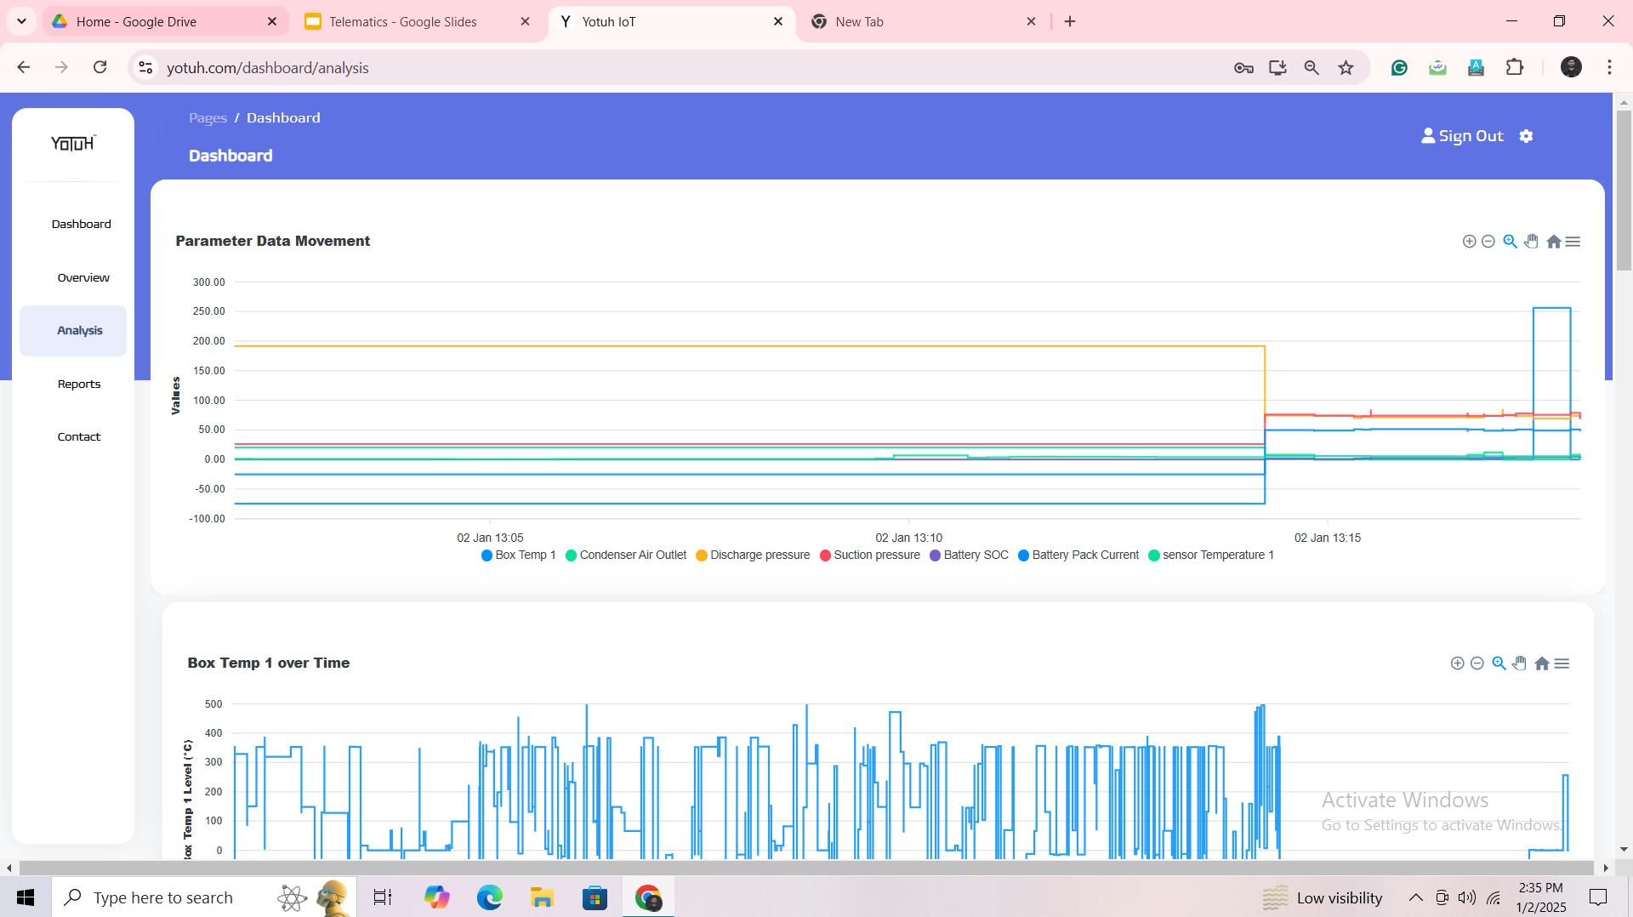
Analysis Page;
Parameters to load
All data in CAN Frame 1 to 7.
Temp Sensor 1 to 8, etc
For customers only show few items in drop down menu.
All parameters in one graph.
Left Y Axis for 50 to -25.
Right Y Axis for 400 to 0.
----
For the data coming in 0 and 1. Scale them to 100 and 0.
Vehicle Selection Drop Down Box
Parameters to load
Start Time and Finish Time

Slide 10
Analysis Page;
Drop down menu available for Admin
Drop Down Vehicles
Admin could see all vehicles
Drop Down Parameters
Temp Sensor 1
Temp sensor 2
Temp Sensor 3
Temp Sensor 4
Temp Sensor 5
Temp Sensor 6
Temp Sensor 7
Temp Sensor 8
Box temperature
Discharge Pressure
Suction Pressure
Compressor Current
Compressor RPM
Set Point
TTd/TTtc
Hysteresis
Cooling State
Door State
Charging Status
SOC
Current
Total Odometer
Drop down menu available for Customers
Drop down Vehicles
Customer could see only his vehicles
Drop Down Parameters
Box Temperature
Set Point
Cooling State
Door State
Charging Status
SOC
Total Odometer

Slide 11
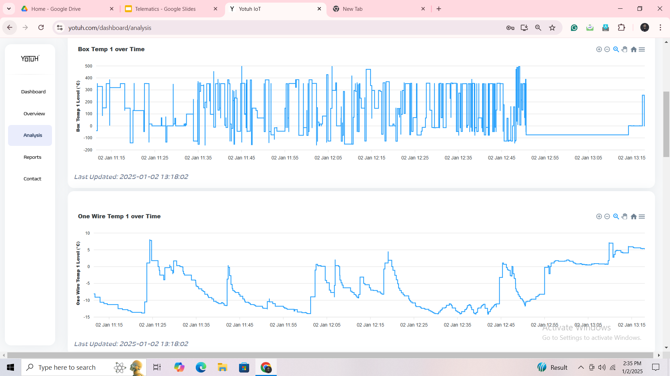
Analysis Page;
Then whatever parameters were selected earlier.
Just show graph for each parameter one by one.
Graph to have a zoom in, zoom out, PAN, reset button.

Slide 12
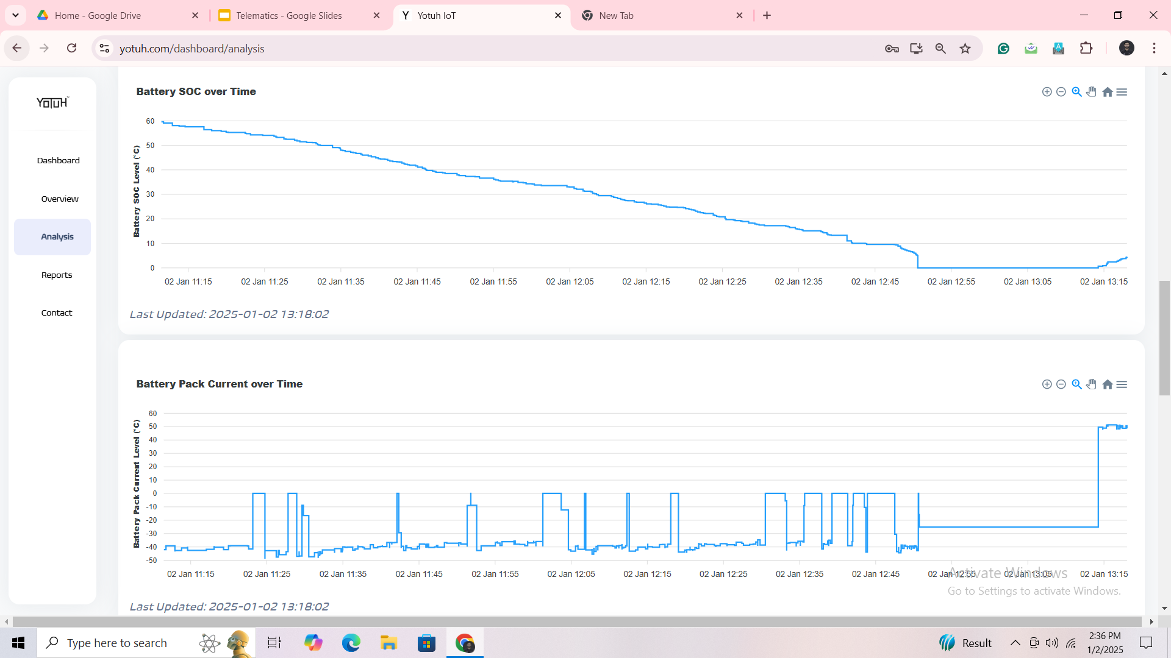

Slide 13
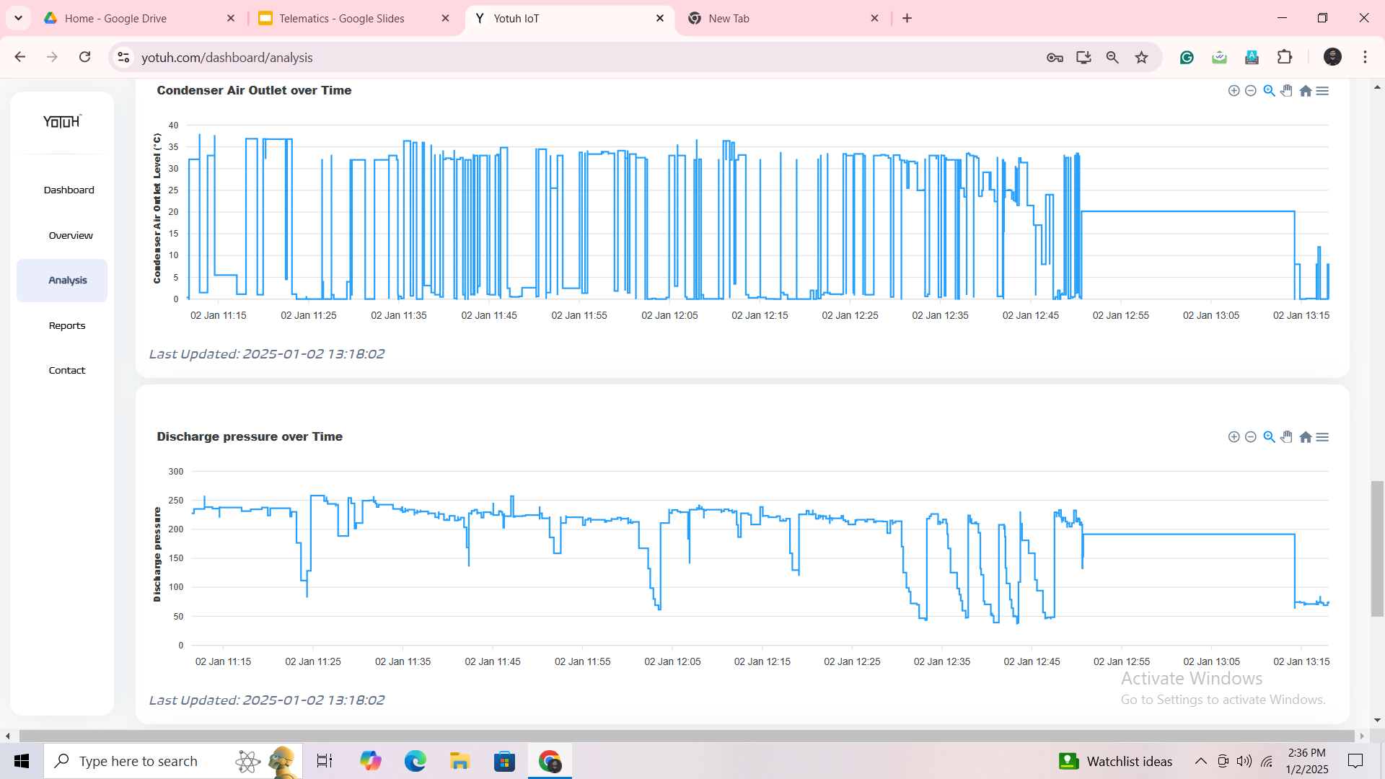

Slide 14
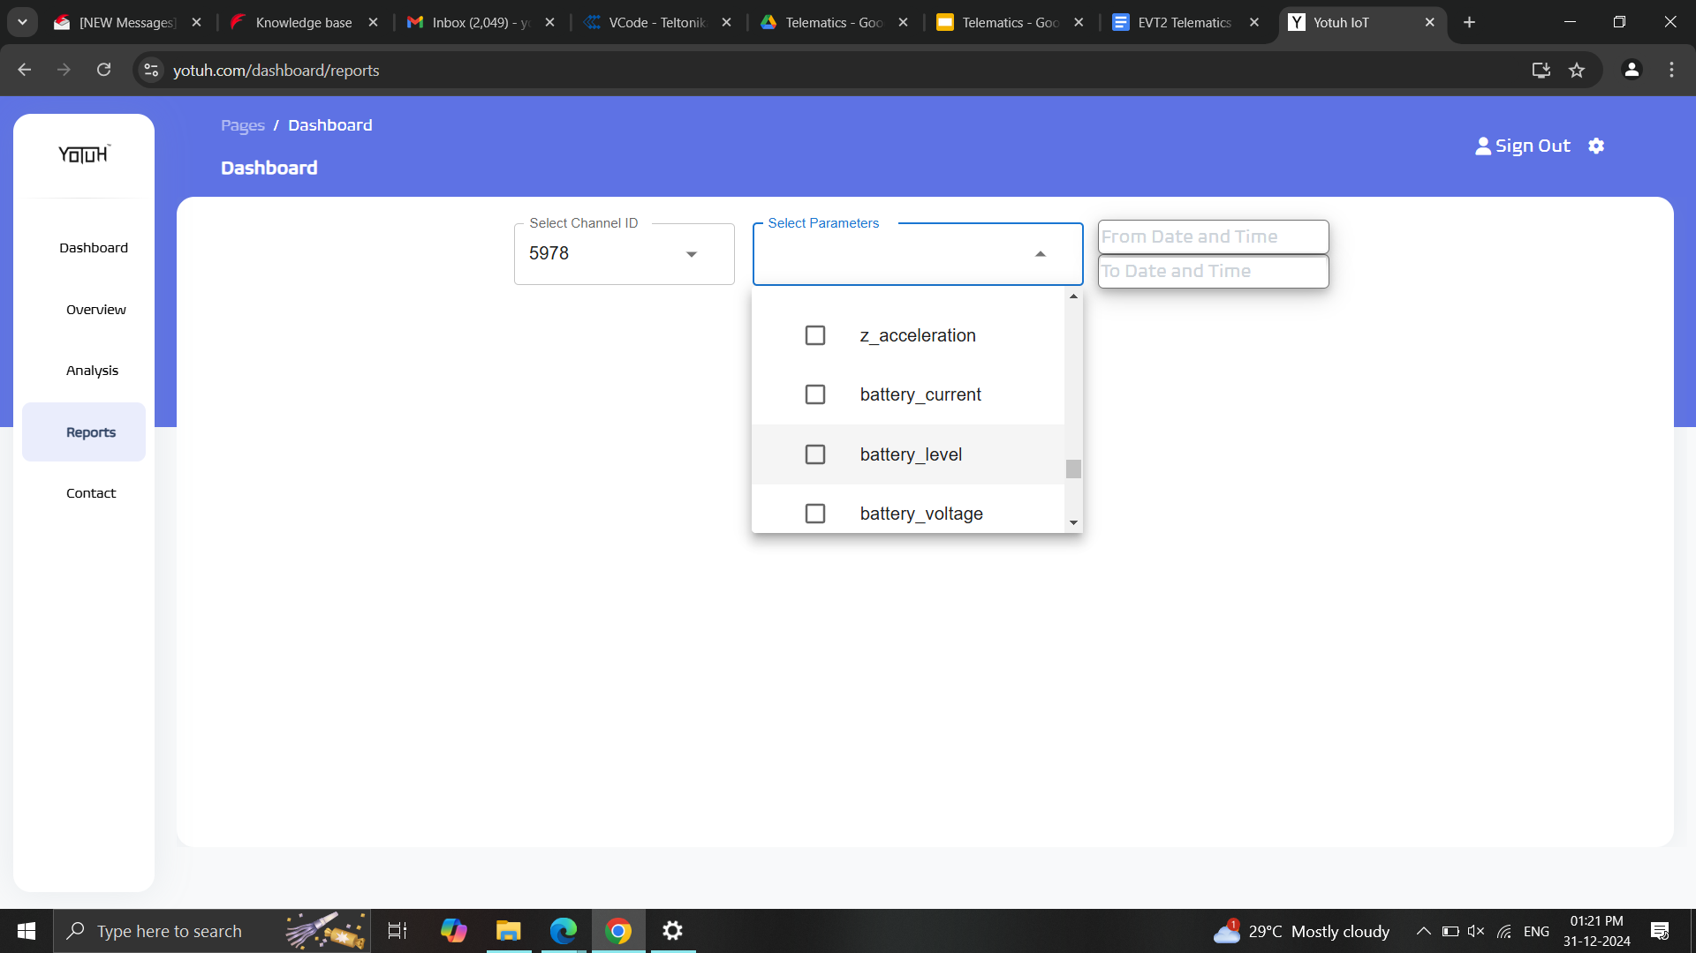
Reports Download Page

Slide 15
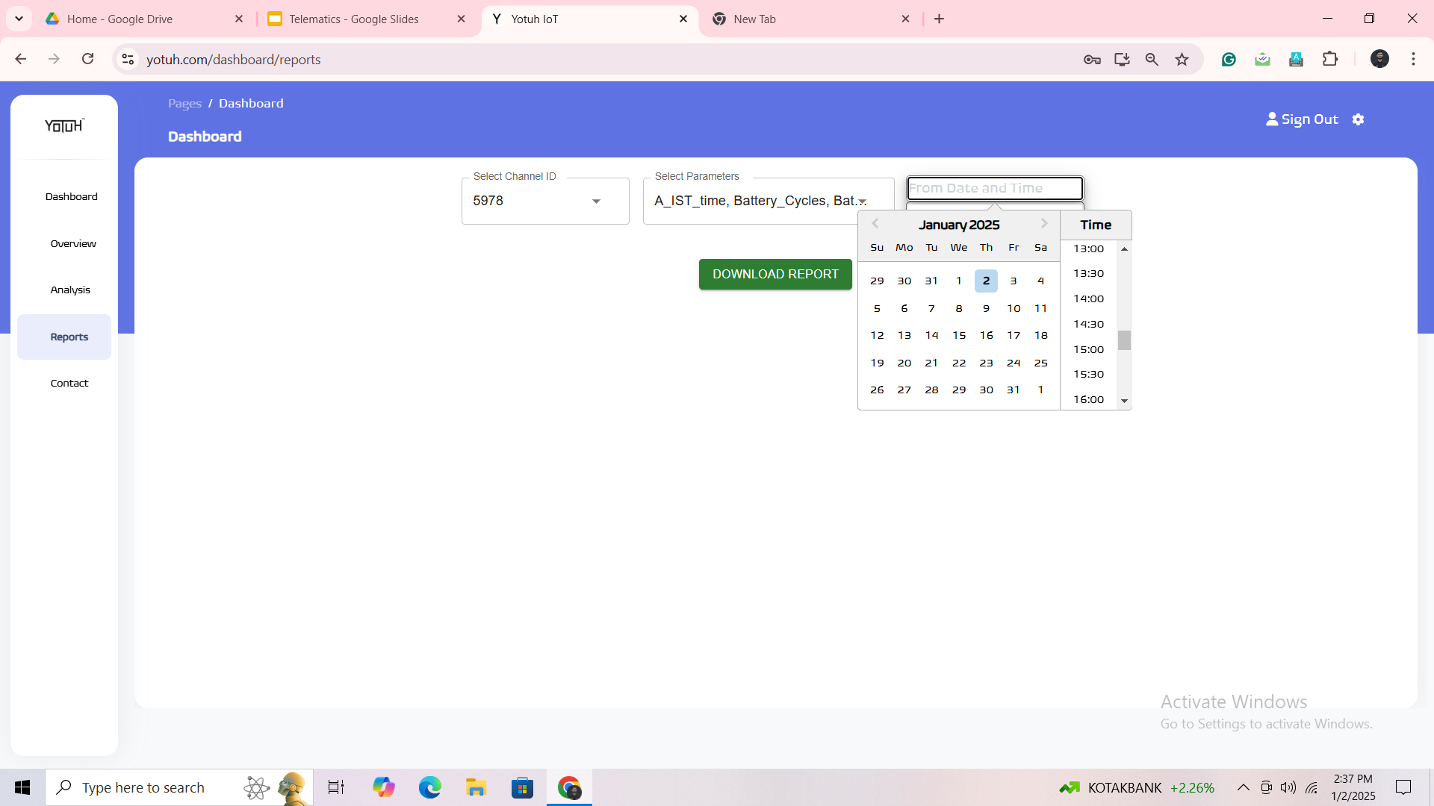
Reports Download Page
Vehicle Selection Drop Down Box
Parameters to load
Start Time and Finish Time
Download EXCEL format

Slide 16
Report Page;
Drop down menu available for Admin
Drop Down Vehicles
Admin could see all vehicles
Drop Down Parameters
All 35 points mentioned in CANData from Yotuh ECU
All 28 points mentioned in Data Collected from IOT Hardware
Drop down menu available for Customers
Drop down Vehicles
Customer could see only his vehicles
Drop Down Parameters
Box Temperature
Set Point
Cooling State
Door State
Charging Status
SOC
Total Odometer
Vehicle Speed
Latitude and Longitude

Slide 17
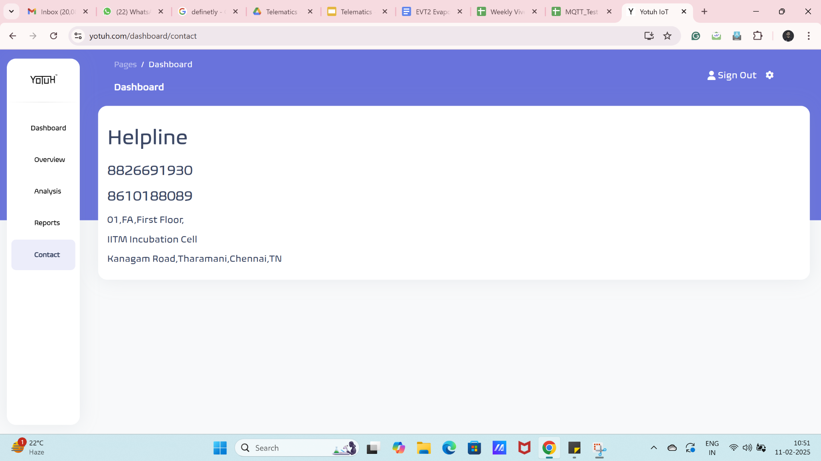
Contact
Contact:
8826691930
8610188089
8903532781
Address:
39C, 2nd Main Road,
Ambattur Industrial Estate,
Chennai - 600058

Slide 18
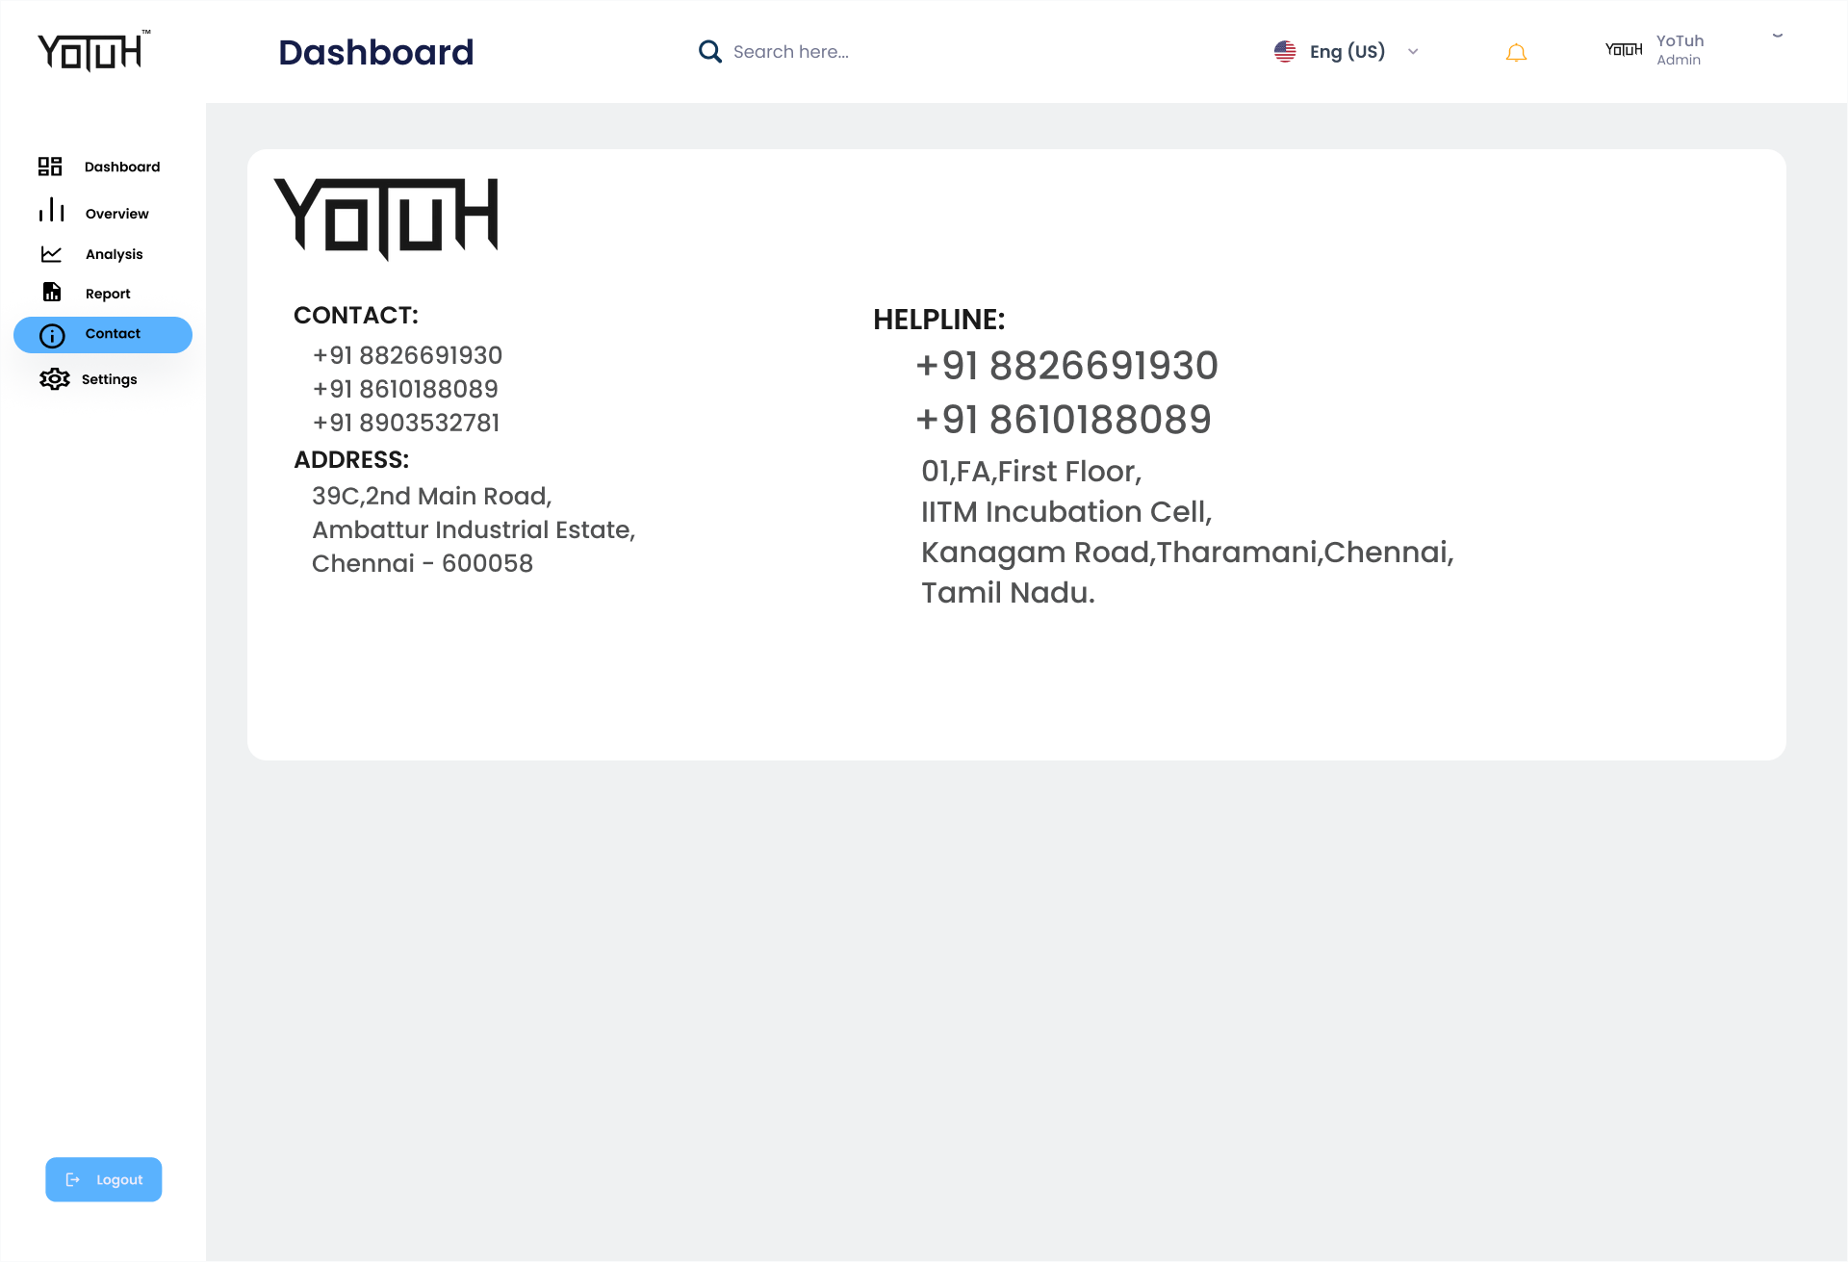
Remove this. Only the write one is sufficient.

Slide 19
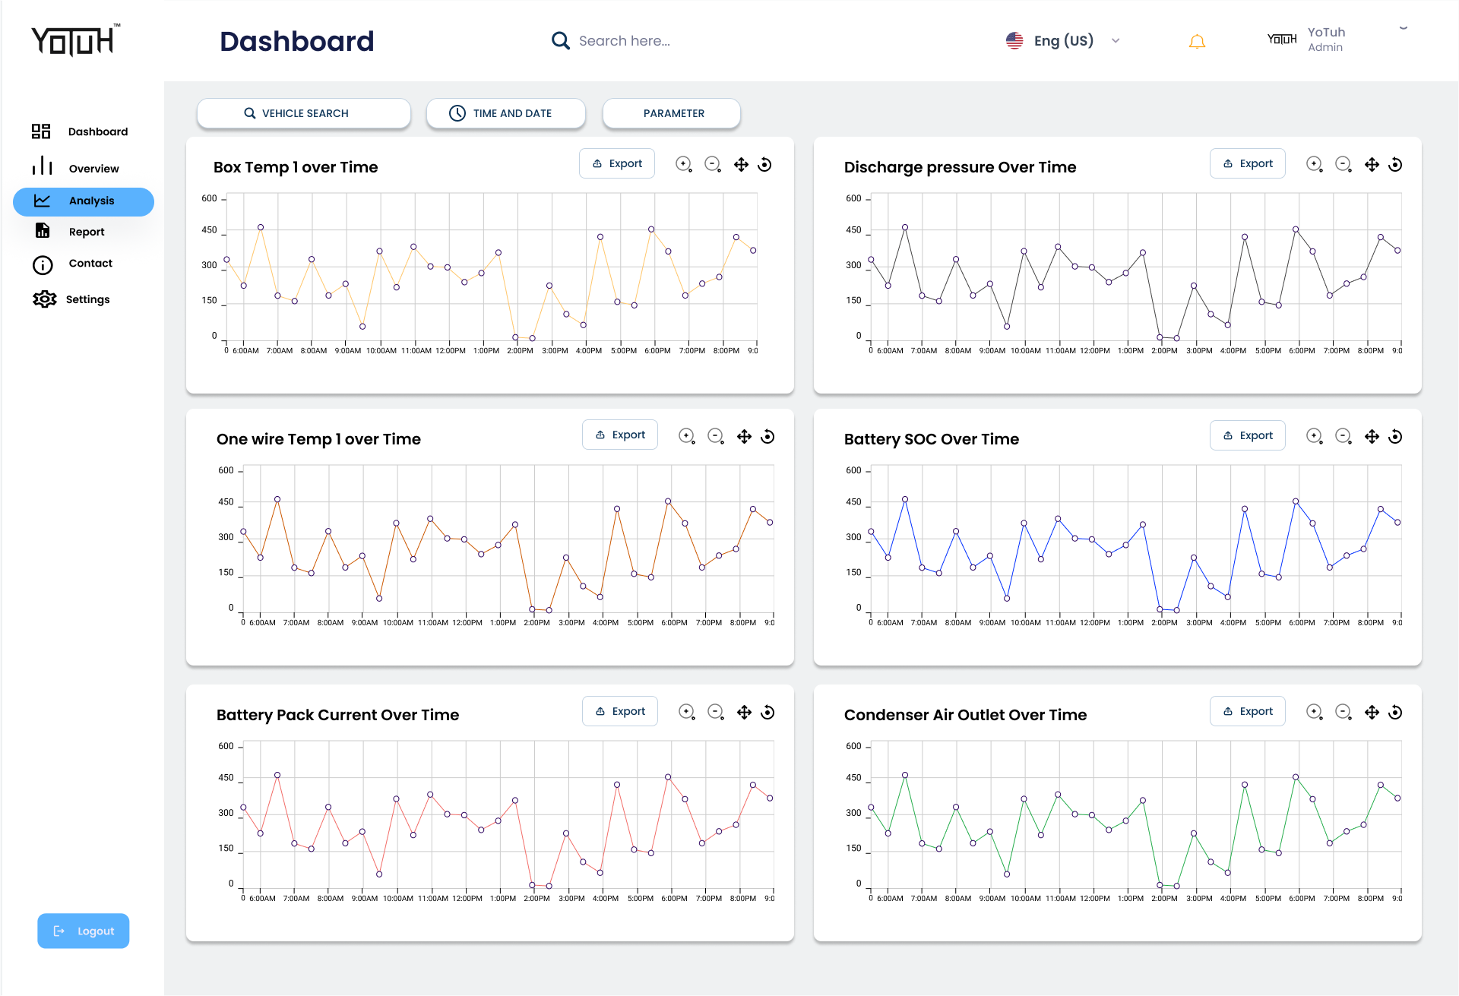
Instead of dots. Can it be a smooth graph.

Slide 20
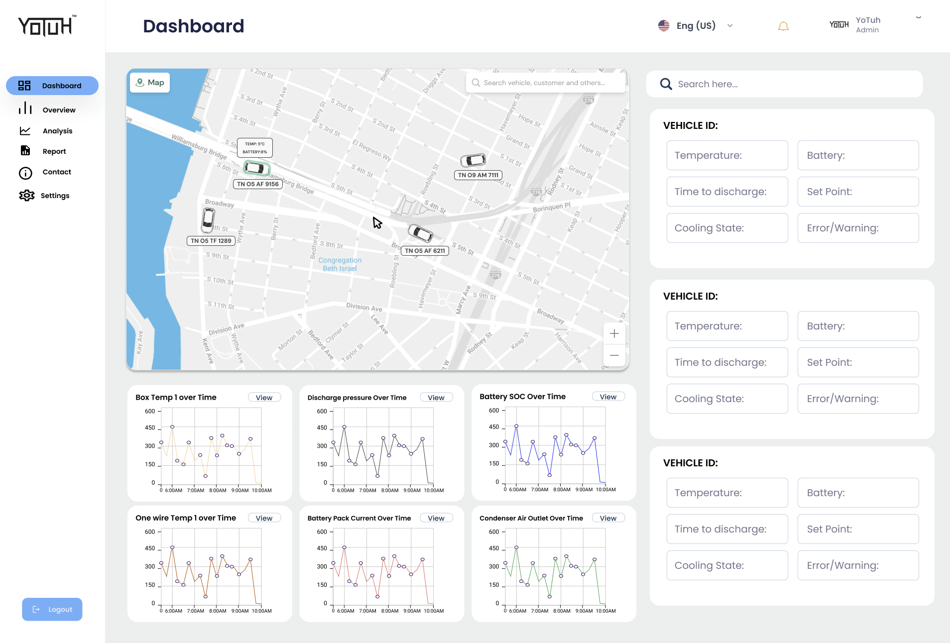
In Dashboard Page itself, you have added few graphs. We could remove them,

Slide 21
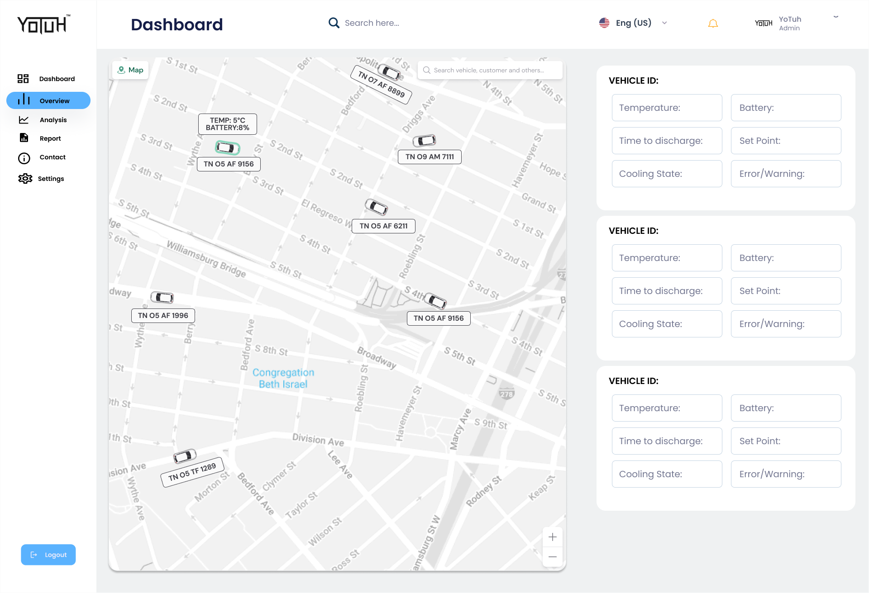
Overview Page is intended for trip overview/summary.
In this on the top, user should select vehicle and time.
Then user could see the vehicle movement on the maps.
Refer to slides.

